Slide 1
Hotel Booking Analysis PYTHON EDA PROJECT
By - lalita Rautela

Slide 2
Table of contents
Agenda of Data Analysis
.
01
Hotel Booking Data-Introduction
02
Benefits for doing this Hotel Booking Analysis Project
Short introduction of the Dataset
03
Data Description & Summary
EDA (Exploratory Data Analysis)
04
Dataset Summary & Description of all the data
Data Visualization, Overall Stats and Conclusion

Slide 3
Agenda of Data Analysis
Have you ever wondered when the best time to book a hotel room is?
Or the optimal stay length of stay to get the best daily rate?
What if you wanted to predict which hotel likely to receive a disproportionately high number of special requests?
So, this hotel booking dataset can help us to explore all of this questions!

Slide 4
Hotel Booking Data Introduction
This Dataset contains data that compares various booking information between two hotels, City Hotel and Resort Hotel. So, here i will be using the data to analyze the factors affecting the hotel bookings. These factors can be used for reporting trends and predict the future bookings.
This Dataset contains the booking data
of hotels from year 2015-2017.

Slide 5
Data Summary
32025
This data set contains a single file which compares various booking information between two hotels: City Hotel and Resort Hotel. Includes information such as when the booking was made, length of stay, the number of adults, children, and/or babies, and the number of available parking spaces, among other things.
The dataset contains a total of 119390 rows and 32 columns.
All the columns are divided into three dtypes : Object, float64 and int64.
This dataset does have duplicated values as well as null values. There are total of 32025 duplicate values and four columns have missing values/ null values.
The maximum number of missing values are from 'Company' column then followed by 'Agent', 'Country' and 'Children' columns. The 'Children' column consists of only 4 null values, while 'Company' column consists of 112593 null values.

Slide 6
Points for Discussion
Top Most Preferred Hotel & Hotel Rooms
ADR (Average Daily Rate)
Repeated Vs Non-Repeated Guests
Most Preferred Meal
Distribution Channel Vs ADR
Top Booking Months & Year
Confirmation Vs Cancellation
Mostly Arrived Customers/ Visitors
Overall Stats
Conclusion

Slide 7
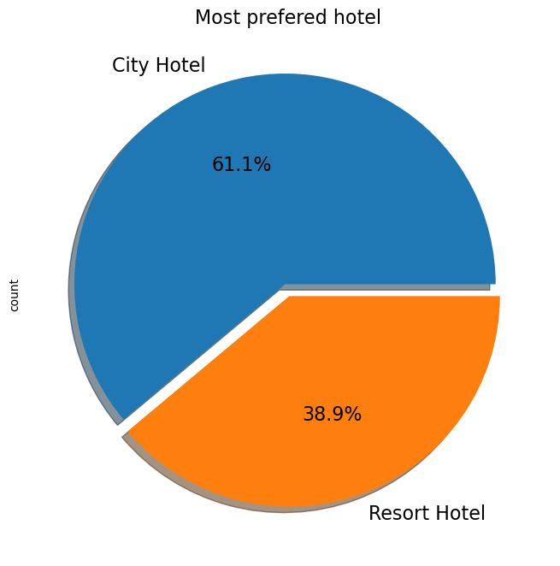
Top Most Preferred Hotel
Insights found
From the chart, we got to know that City Hotel is most preferred hotel by the guests. Thus City Hotel has maximum bookings. 61.1% guests are preferred City Hotel, while only 38.9% guests have shown interest in Resort Hotel.

Slide 8
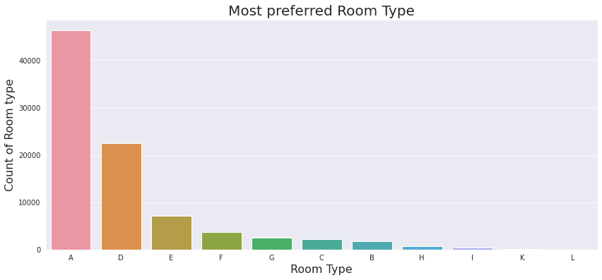
Most Preferred Hotel Rooms
It is found that the most preferred Room type is 'A'. So, majority of the guests have shown interest in this room type.
There are positive impacts because 'A', 'D', 'E' is more preferred by guest due to better services offered in room type.

Slide 9
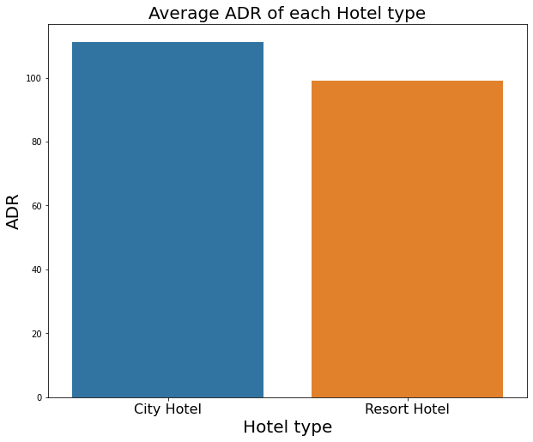
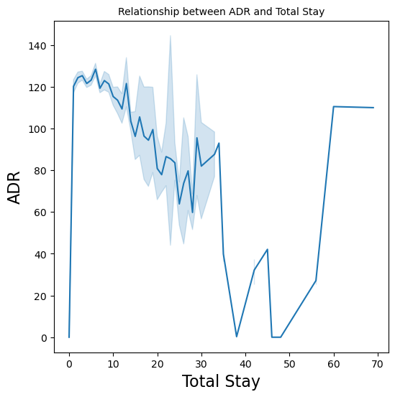
Average Daily Rate
City Hotels are generating more revenues than the Resort Hotels, because City hotel has the highest ADR. More the ADR, more will be the revenue.
From the line chart, we have found that as the total stay increases the ADR is also getting high. So, ADR is directly proportional to total stay.

Slide 10
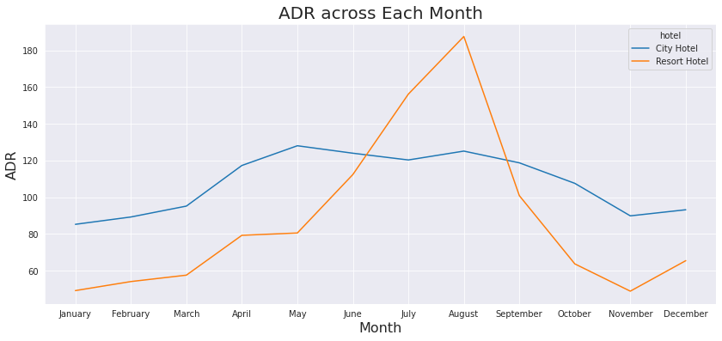
Average Daily Rate
ADR across months
For Resort Hotel, ADR is high in the months of June, July, August as compared to City Hotels. The reason may be that customers/people want to spent their summer vacation in Resort Hotels.

Slide 11
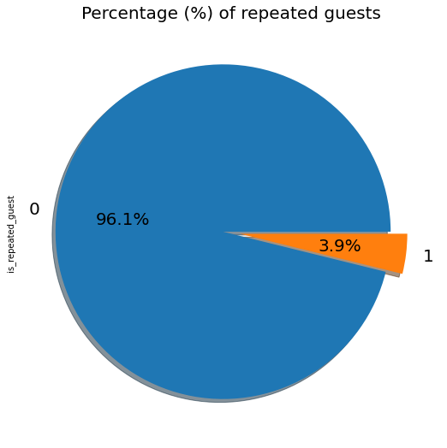
Repeated Vs Non-Repeated Guests
Insights found
The pie chart show the percentage of repeated guests or not (where 0 is not repeated guest and 1 is repeated guest)
Repeated guests are very few which is only 3.9% while 96.1% guests are not returning to the same hotel.
The guests management should take feedbacks from guests and try to improve the services.

Slide 12
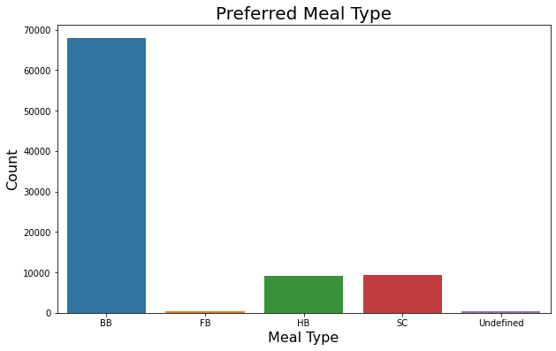
Most Preferred Meal
Insights found
The most preferred meal type by the guests is BB (Bed and Breakfast) while HB (Half Board) and SC (Self Catering) are equally preferred..

Slide 13
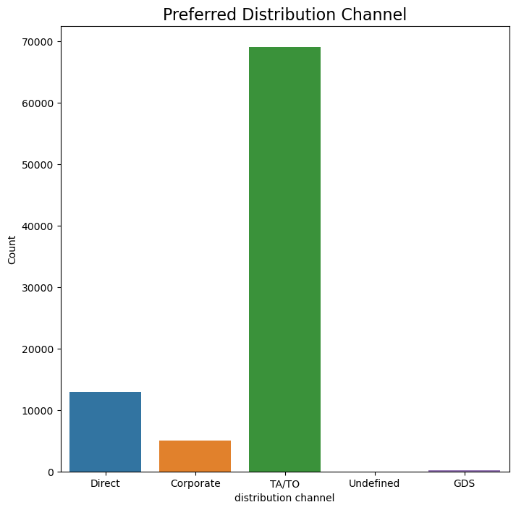
Maximum used Distribution Channel
Insights found
'TA/TO' has been mostly used for booking hotels. Following by Direct and corporate.

Slide 14
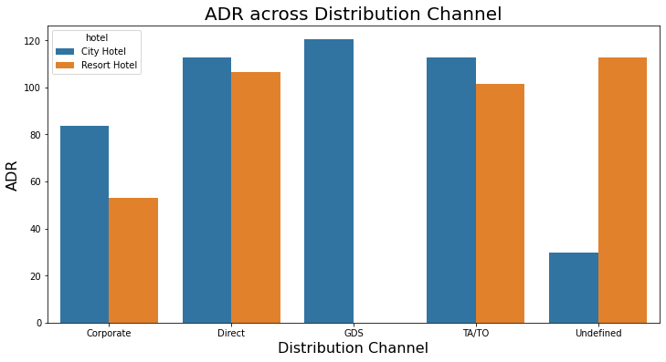
Distribution Channel Vs ADR
'Direct' and 'TA/TO' have almost equally contribution in ADR in both type of hotels. While, GDS has highly contributed in ADR in 'City Hotel' type. GDS needs to increase Resort Hotel bookings.

Slide 15
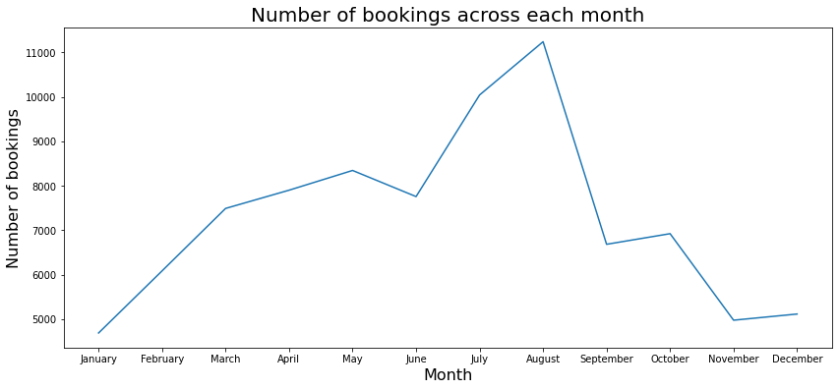
Top Booking Months
From this graph, we can say that July and August months had the most Bookings. As, July and August generally surrounds in and near the summer vacation.
Hotels should be well prepared for the month of July and August as maximum bookings takes place for this month.

Slide 16
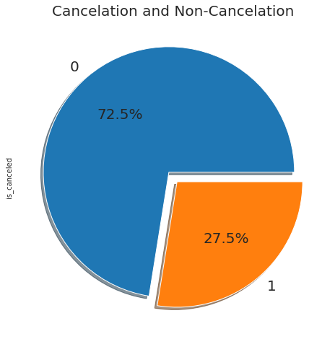
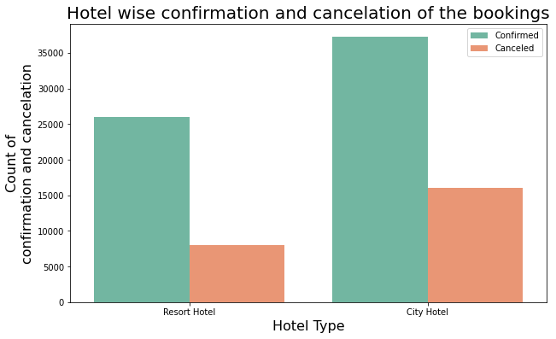
Confirmation Vs Cancellation
More than 1/4th of the overall bookings i.e. approx 27.5% of the tickets was got canceled.
We can clearly deduce from the 2nd graph that the City hotel is having greater number of bookings as compared to Resort hotel. But, the cancelation percentage is also high of the City Hotel.

Slide 17
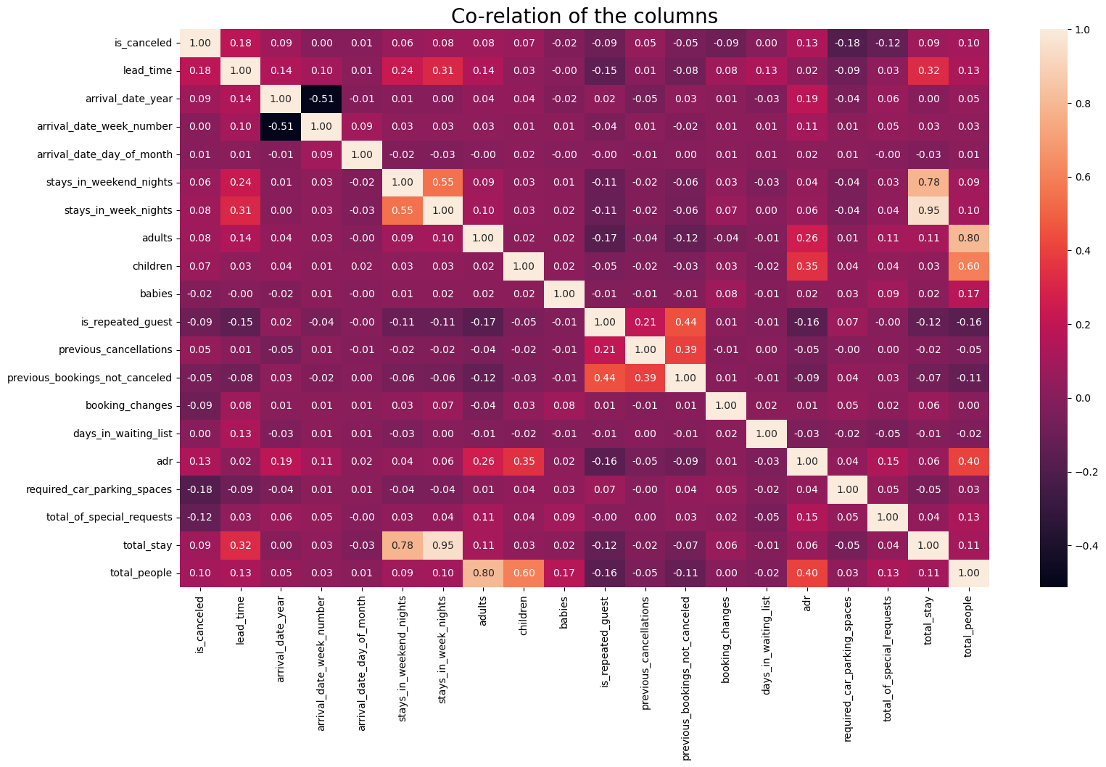
Overall Stats
Correlation Heatmap

Slide 18
Overall Stats
Insights found
From Heatmap
is_canceled and total_stay are negatively correlated. This means customers are unlikely to cancel their bookings if they don't get the same room as per reserved room.
lead_time and total_stay is positively correlated. This means more the stay of customer is, more will be the lead time.
adults, childrens and babies are correlated to each other. This indicates more the people, more will be ADR.
is_repeated guest and previous bookings not canceled have a strong correlation. This may be due to the reason that repeated guests are not more interested to cancel their bookings.

Slide 19
Conclusion
City hotels are the most preferred hotel type by the guests. So, we can say that City hotels are the busiest hotel in comparison to the resort hotel.
The average ADR of city hotels is higher as compared to the resort hotels. So, it can be said that these City hotels are generating more revenue than the resort hotels.
The total stay of guests is directly proportional to the adr. So, higher the days of stay, the higher will be ADR and revenue as well.
The percentage of repeated guests is very low. Only 3.9% people had revisited the hotels. Rest 96.1% were new guests. So, retention rate is much low.
Among different types of meals, BB (Bed & Breakfast) is the most preferred type of meal by the guests. So, guests love to opt for this meal type.

Slide 20
Conclusion
'Direct' and 'TA/TO' have almost equally contribution in ADR in both type of hotels. While, GDS has highly contributed in ADR in 'City Hotel' type.
Most number of bookings have taken place in the month of July and August. July and August are the favorite months of guests to visit different places.
The mostly used distribution channel is TA/TO(Travel agents/tour operators).
While calculating ADR across different month, it is found that for Resort hotel, ADR is high in the months of June, July, August as compared to City Hotels.
Almost 1/4th of the total bookings is canceled. Approx, 27.5% bookings have got canceled out of all the bookings.
Majority of the guests have shown interest in the room type 'A'. Room type 'A' is the most preferred room type.

Slide 21
Thank You

